Slide 1
DrEYEve
Perception System for Autonomous Vehicles Using NVDLA
Nitya Mitnala Rithani Priyanga Vishnuvartthan
Notes:
Intro.

Slide 2
Why ?
Motivation and Goals
Objective: Develop an efficient object detection model for real-time road analysis in autonomous vehicles.
Motivation: Enhance computational efficiency using NVDLA and gain insights with performance metrics.
Required metrics for self driven vehicles:
Inference time: less than 50 ms
Accuracy mAP above 90% for critical tasks

Slide 3
How ?
Dataset aquisition
Implementation of YOLOv5 on the dataset to train the model.
Model Conversion: Converted YOLOv5 to ONNX format.
Optimization: Use TensorRT to optimize the model for NVDLA.
Deployment: Run inference on the NVDLA platform.
Performance Tuning:
Quantization
Profiling

Slide 4
Tech Stack Used
Task
Dataset preparation, initial training of YOLOv5 on dataset.
Model optimization with TensorRT and conversion to ONNX.
Run Post-training Quantization on the trained model and run inference, configure NVDLA platform, load optimized model, run initial performance tests.
Optimization for efficiency and parallel processing, final validation, documentation.
Tech Stack: ubuntu, YOLOv5 model. Language: Python for YOLOv5, hardware simulation of NVDLA (already available open source platform)
Outcomes: Have an efficient model based on NVDLA that has the capability to detect objects on the road real-time, that can be deployed on an autonomous vehicle.

Slide 5
Dataset
Dataset used : Manhole Detection Dataset that consists of 2677 images that are annotated for the YOLO format
https://github.com/sh-r/Manhole_Detection/tree/master/resources

Slide 6
Model Selection: YOLOv5
Best Precision and highest speed obtained with YOLOv5 and YOLOv8 (suitable for real-time applications)
(https://www.augmentedstartups.com/blog/yolov8-vs-yolov5-choosing-the-best-object-detection-model#:~:text=Both%20YOLOv8%20and%20YOLOv5%20are,require%20real%2Dtime%20object%20detection. )
Pretrained on MS COCO dataset for object detection (weights obtained from Ultralytics)
Trained on dataset for manhole detection. Size of dataset: 2677 annotated for YOLOv5 images, split into train, validation and test datasets.

Slide 7
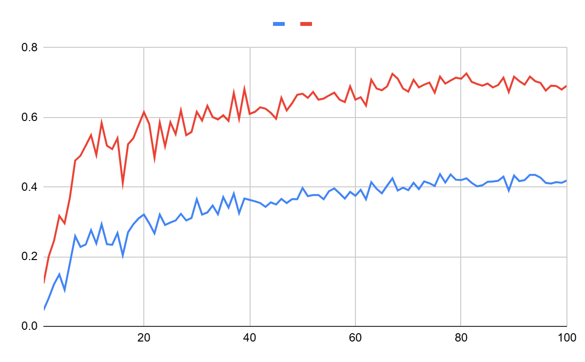
YOLOv5 Training Precision Results:
Key:
Red: mAP @ 0.5
Blue: mAP @ 0.5:0.95
Time taken for training 100 epochs: 2.065 hours
mAP @ 0.5 is reaching about 70%
mAP @ 0.5:0.95 is reaching about 40%
Have to run inference.

Slide 8
Hardware Setup

Slide 9
NVDLA Platform:
Improvements that can be made:
Computational Power (Parallel Processing)
Memory improvements
Energy efficiency
Configurable Features of NVDLA:
Data types.
Input image memory formats.
Weight compression.
Winograd convolution.
Batched convolution.
Convolution buffer size.
MAC array size.
Second memory interface
Non-linear activation functions.
Activation engine size.
Bridge DMA engine.
Data reshape engine.
Pooling engine presence.
Pooling engine size.
Local response normalization engine presence.
Local response normalization engine size.
Memory interface bit width.
Memory read latency tolerance.
Notes:
Energy efficiency is especially important because we want to deploy it in autonomous vehicles

Slide 10
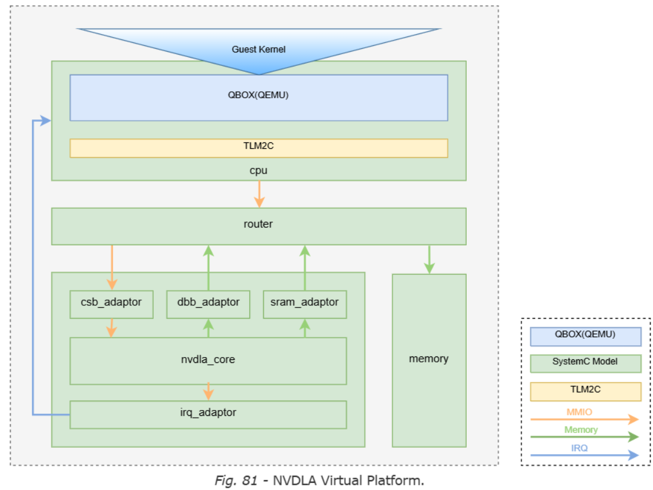

Slide 11
NVDLA Setup
Ubuntu 14.04
$cmake -DCMAKE_INSTALL_PREFIX=[install dir] -DSYSTEMC_PREFIX=[systemc prefix] -DNVDLA_HW_PREFIX=[nvdla_hw prefix] -DNVDLA_HW_PROJECT=[nvdla_hw project name]
$ ./build/bin/aarch64_toplevel -c conf/aarch64_nvdla.lua
Docker
$ docker pull nvdla/vp
$ docker run -it -v /home:/home nvdla/vp
$ cd /usr/local/nvdla
$ aarch64_toplevel -c aarch64_nvdla.lua

Slide 12
Conversion to Compatible Format:
Converted to ONNX format
Found that ONNX format is incompatible with NVDLA
Solution 1: Onnx2caffe
Requirements: onnx, onnx-simplifier
Optimizing the model of conversion: Python3 -m onnxsim yolov5.onnx yolov5-modified.onnx
Converting with onnx2caffe
python convertCaffe.py ./model/MobileNetV2.onnx ./model/MobileNetV2.prototxt ./model/MobileNetV2.caffemodel
Solution 2: TensorRT
Requirements: Cuda 12.6, cDNN 8.9
Onnx -> TensorRT (.trt) -> deploy in NVDLA
trtexec —onnx=yolov5.onnx —saveEngine=yolov5_dla.trt —useDLACore=0 —allowGPUFallback
Notes:
YOLOv5 is an object detection model that can detect objects in real-time
Looked at three datasets: 1: drivable area detection on roads
2: semantic segmentation in urban environments: images labelled pixel-wise
3: Focused on road level images. Detection of manholes and drains as obstacles in the road.
Running the YOLOv5 model on NVDLA: Involves first setting up the NVDLA environment. Mainly need to run it on ubuntu, install necessary drivers.

Slide 13
Next Steps
Load TensorRT optimized model onto NVDLA platform and run inference.
Performance Tuning: Quantization and Profiling

Slide 14
Thank You!

